Slide 1
Fundamental of Networks and Security
Markos Vassilis
Mediterranean College
Week 05

Slide 2
A Quick Revision

Slide 3
What we saw last time…1 / n
Which are the layers of the OSI model?
The OSI model comprises of 7 layers:
Physical
Data Link
Network
Transport
Session
Presentation
Application

Slide 4
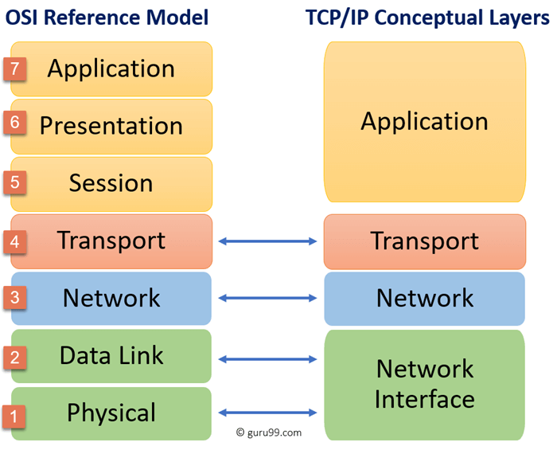
What we saw last time…2 / n
Which are the TCP/IP Conceptual layers and what is their correspondence with the OSI ones?
There are four layers:
Network Interface
Network
Transport
Application

Slide 5
What we saw last time…3 / n
What are some benefits of using models to describe networks architecture?
Some benefits include:
Global representation of multiple, highly diverse systems.
Facilitates understanding of networks and similar concepts.
The core processes are predetermined. We don’t have to worry about them (at an abstract level).
We need to take care of how information flows across layers (i.e., how the information flow across processes).

Slide 6
What we saw last time…4 / n
What is encapsulation?
Encapsulation is the process of adding information incrementally, as we move “downwards” through the layers, i.e., from the more abstract to the more lower-level layers.
What is decapsulation?
The opposite of encapsulation, i.e., moving backwards, from lower- to higher-level layers, we make use of and strip off the enabling information, thus efficiently getting back the original data.

Slide 7
What we saw last time…5 / n
Port, IP, MAC: What does each of these help us identify?
Ports help us identify the exact location from where on a network device a process is made available.
IP address helps us identify a network.
MAC address helps us identify a certain network device.
Right or Wrong? A packet contains more information than a frame.
Wrong. Frames = Packets + MAC address.

Slide 8
What we saw last time…6 / n
Right or Wrong? Packets refer to lower layer than frames.
Wrong. Frames, refer to layer 2 but packets to layer 3 - remember, frames are encapsulated packets, so we move down the layer stack!
At which layer of the OSI model do message segments live in?
At the transport layer (layer 4).

Slide 9
What we saw last time…7 / n
Name some pros and cons of message segmentation.
Pros:
Different conversations can be interleaved (i.e., you can perplex multiple conversations simultaneously).
More reliable networks.
Con:
Complexity

Slide 10
Network Topologies

Slide 11
Bad Networks: Vol I
In an office network, why are the following bad?
You can’t access your local printer
Lack of local (internal) accessibility.
You can download stuff from all over the internet.
Lack of restrictions on external access.
When you download a Trojan, all PCs are infected.
The design of the network should have taken this into account (logical security).
There are no firewall devices
Lack of physical security

Slide 12
Bad Networks: Vol II
You share a 3MB .png which takes roughly 8 minutes to complete.
Lack of a fast connection, large delays.
You want to connect to your local databases or any other service but, hey, Error 404 is there for you.
Unreliable.
It’s high time to connect some new devices but the connecting machinery you are using is as old as the deceased Queen Elizabeth.
Lack of “future-proof” design.

Slide 13
Good Networks
Revert the above and you get all the good network design principles:
Internal accessibility (you should have access to any device you need to)
External access (see and show what you should from / to the world)
Logical security (take care of security at the design level of the network)
Physical security (remember those firewalls?)
High transfer speed / minimal delays (www.google.com should load instantly)
Reliability and Resilience (you should not fear that you will get disconnected every time the clock ticks)
Adaptable to extensions / future needs (you should not build a network only for today)

Slide 14
Topology
What is topology?
Topology is concerned with the properties of a geometric object that are preserved under continuous deformations, such as stretching, twisting, crumpling, and bending
Nooooo! This is mathematics - see here for more.
Network topology is the arrangement of the elements (links, nodes, etc.) of a communication network.
In everyday words: Topology is the logical and physical “cabling” of the network.
But, which words aren’t “everyday” ones?

Slide 15
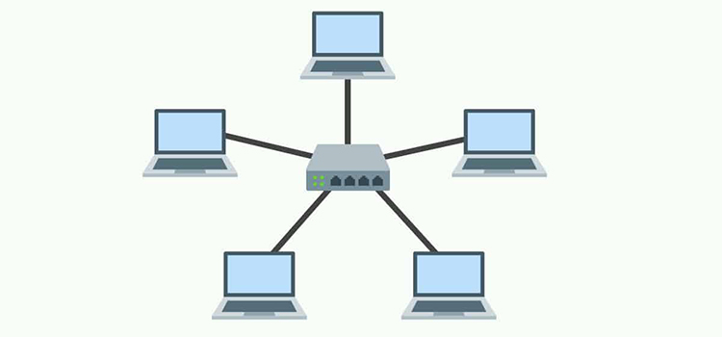
Network Topologies: Star
Spokes
Hub

Slide 16
Network Topologies: Star
Quite common in most simple / small / home networks.
Quite common in data networks.
The “Hub” is not necessarily a hub (actually, it never is, in our days). It is a logical entity, which means that it might be implemented by several devices.
We discuss about physical connections but not about physical layouts! For instance, devices might be in different floors, rooms, buildings (?) etc. These all are part of the network layout!

Slide 17
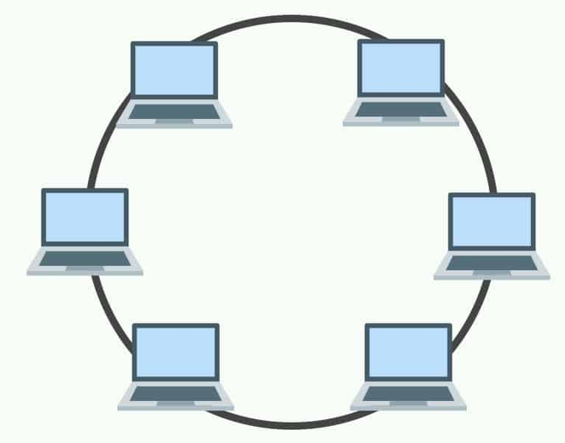
Network Topologies: Ring
All devices connected circularly, as a ring.
Many times, devices are all connected to some central “hub” which implements the ring connection.
What if one connection is lost?
No problem!
What if two connections are lost?
Problem!
Barely used.

Slide 18
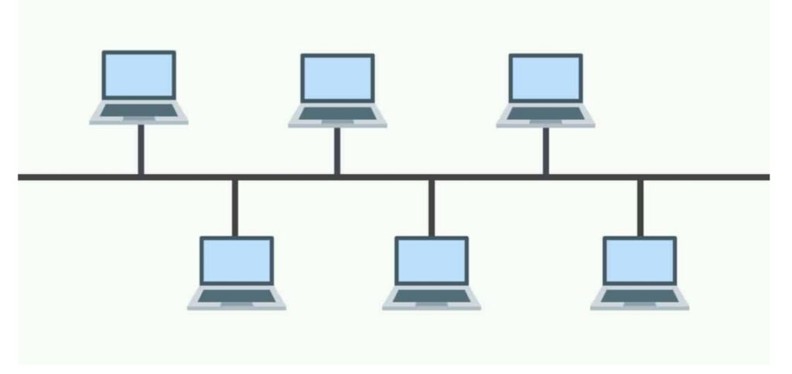
Network Topologies: Bus

Slide 19
Network Topologies: Bus
Pros:
Cheap (both to think / design and to implement).
Useful when all things should fail at the same time (i.e., serial behaviour, e.g., automotive applications and other control systems)
Cons:
Really slow.
What if somebody intercepts? Security!
How many messages can travel at the same time?
Only one…

Slide 20
Network Topologies: Wireless
Pros:
Cheap (both to think / design and to implement).
Useful when all things should fail at the same time (i.e., serial behaviour, e.g., automotive applications and other control systems)
Cons:
Speed depends heavily on physical parameters (obstacles etc).
What if somebody intercepts? Security!
How many messages can travel at the same time?
Only one…

Slide 21
(Reminder) Hubs
Unique name -> (Media Access Control) MAC Address: 12-character alphanumeric code, unique for each device in a network, e.g., 00-A1-D2-C4-55-4A.
A simply “clever” middleware could be as follows:
Simply “clever” middleware -> Hub.
Information flows towards all directions (the hub is oblivious to which is the target port / device).
Can you see the problem here?
Too many collisions (we shall cover this extensively throughout the course).
Hubs are not used anymore (really problematic).
source
C
target

Slide 22
(Reminder) Layer 2 Switches
But, why not take advantage of local connectivity?
A “really clever” middleware could take advantage of the local physical connections to direct information properly:
00-BC-11-22-A4-17:↑ 00-AA-BC-1F-DE-33:← 00-DD-DD-C6-64-4B:→ 00-32-21-98-BB-CA:↓
“Really clever” middleware -> Layer 2 switch.
Keep track of which devices (i.e., MAC addresses) are connected to which ports of C.
Essentially, memory is what makes a Layer 2 switch “really clever”.
source
C
target

Slide 23
Collision Domain
Collision Domain: The LAN part (segment) where devices must compete to communicate.
One message at a time in this segment, from one source to one target device.
Collision: When two messages encounter each other on the same “wire”.
How many collision domains are there in a Hub?
One.
How many collision domains are there in a Wireless network?
One.
How many collision domains are there in a Layer 2 Switch?
As many as the ports!

Slide 24
Do we need Broadcasting?
Why broadcast a message since it causes so much trouble?
Some messages are intended for all devices.
“Help!”
To inform that a new device has been installed.
…
Broadcast Domain: The part of the network where a message can be “heard”.
How many broadcast domains on a:
Switch? One.
Router? It depends (remember, they are not just really clever, but amazingly clever). Routers, in general, break broadcast domains!

Slide 25
Why use Switches?
They reduce network congestion by:
splitting the LAN into collision domains;
allowing bilateral communication between any two devices.
They offer many ports at low cost.
They have high speed ports.
They can temporarily remember large frames ( = packets + MAC) so as to help avoiding collisions (really clever, right?).
Switching is performed at the hardware level - so, it is faster than programmable solutions.

Slide 26
Pick your Weapon (aka Device)
What would you consider when looking for network devices?
Cost?
Connectivity? (e.g., number of ports)
Network speed? (hopefully better than your current equipment)
The future? (Is it expandable? Easy to maintain?)
Comprehension? (Can you understand how to use it? Can your colleagues?)

Slide 27
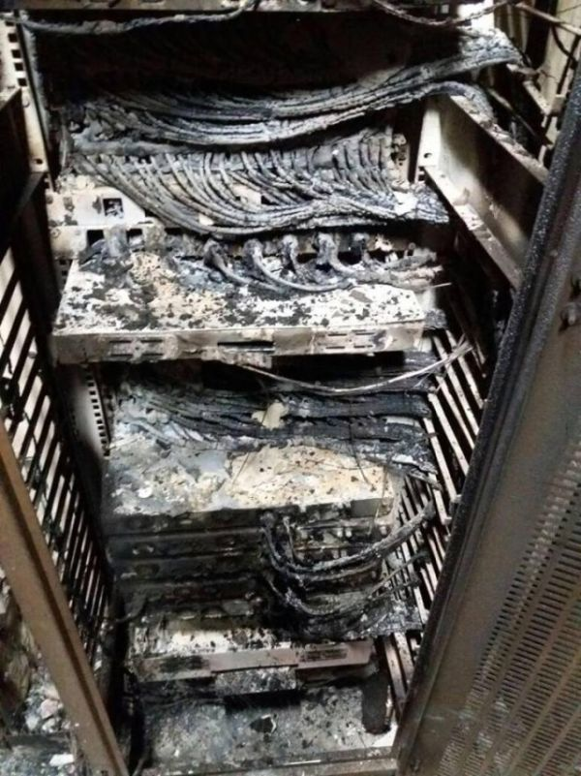
Simple yet Dangerous 1 / n
This is a destroyed server.
Yes, this is a physically damaged computer.
It once worked “like a charm”, but now gone are the days of its youth.
Potential physical damage is probably the no. 1 consideration that goes unnoticed when picking network equipment, but it shouldn’t…

Slide 28
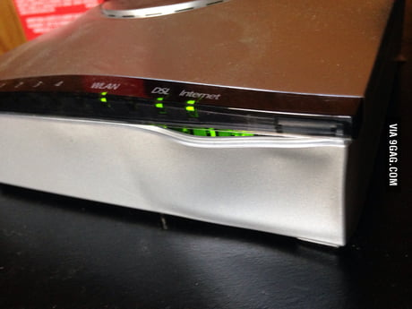
Simple yet Dangerous 2 / n
Yes, electrical devices do melt.
This is a router that has not had a good time in the past.
Extreme temperature can severely hurt electrical devices.
So, take that into account the next time you put your router close to a working heat-pump.

Slide 29
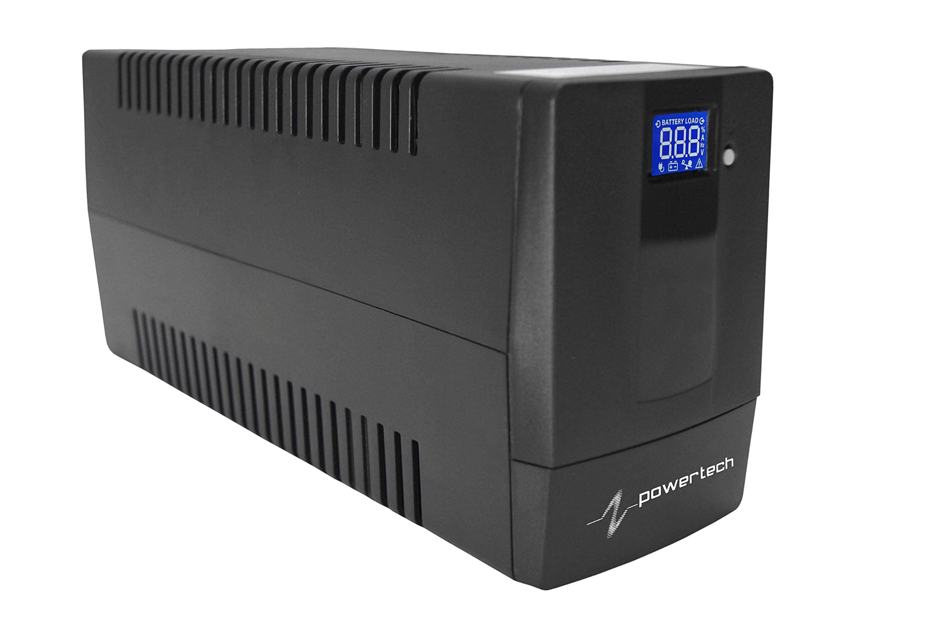
Simple yet Dangerous 3 / n
Do you know what this is?
Oops?
No, UPS: Uninterruptible Power Supply.
This one can save your machines in case of frequent voltage spikes or electrical noise.

Slide 30
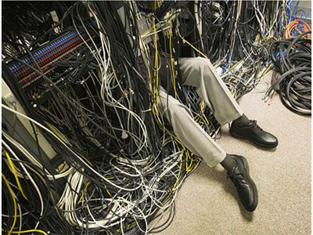
Simple yet Dangerous 4 / n
Poor Homo Sapiens Sapiens trying to figure out how they ended up there…
Maintenance means that you have taken care of proper cabling, labelling, having available spare parts for your network, handling connections properly etc.
Do take those into account!

Slide 31
Reliability
Single Points of Failure: Parts of the network that if a failure occurs you have no back-up plan.
Good or Bad?
In general, bad (e.g., auth access, server access, internet access etc)
Some times tolerable, though (e.g., user access).
Solution?
Redundancy! Duplicate (or even more) some links / parts of the network.
Essentially, back-up plans, e.g., parts of the network that are not used but for cases when the actively used (“main”) ones fail.

Slide 32
Firewalls == Walls of Fire?
Firewalls act like “filters” between two or more networks, filtering:
packets, e.g., Stateful Packet Inspection (SPI): incoming packets must correspond to some request,
applications, e.g., your typical OS Firewall,
URL
Use cases?
Separating you from the Internet.
Separating you from your neighbouring LAN.
Separating you from yourself (i.e., the internal network of your own machine).

Slide 33
(Reminder) Networks of different sizes
PAN: Personal Area Network
LAN: Local Area Network
WLAN: Wireless LAN
SAN: Storage Area Network
MAN: Metropolitan Area Network
WAN: Wide Area Network
Wireless variants of the above…
Small networks: 1 - 200 users.
Medium networks: 200 - 1000 users.
Large networks: 1000+ users.

Slide 34
A Network Grows (in Brooklyn?)
Documentation: how it is built, logically and physically.
Device inventory: what devices are being / have been used.
Budget.
Traffic analysis: what protocols and services are used, what are their traffic requirements etc.

Slide 35
Which devices are part of IP design?
End user devices
Servers
Hosts but not all:
Just those accessible from the Internet.
Intermediate devices.
The IP Addressing scheme should be planned so as to help the network admin:
Troubleshoot.
Control network access.

Slide 36
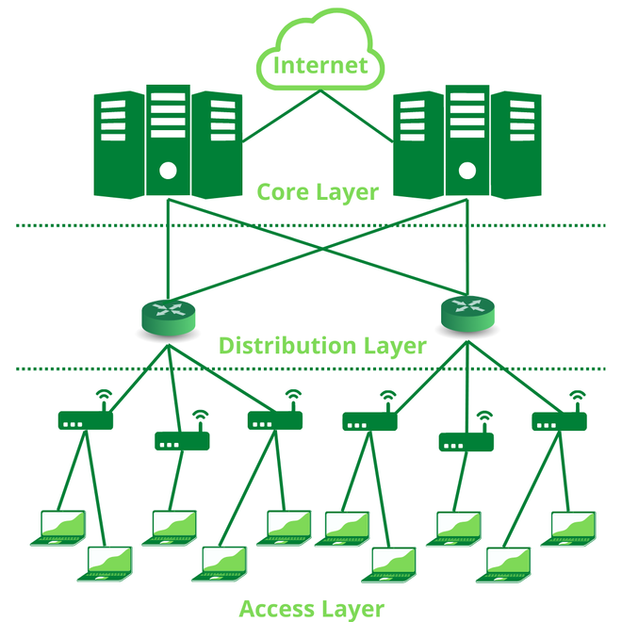
Hierarchical Network Design
Access layer: User-level access to the network.
Distribution layer: Policy-based access.
Core layer: Lower-level access → fast communication between switches.

Slide 37
Access Layer
Layer 2 switches.
Requirements:
High availability
Port security
How is (electric) power transmitted?
Power over Ethernet (PoE): Power “travels” through Ethernet twisted-pair cables alongside data.
Quality of Service (QoS): What is this?
The quality of service offered to you by the network, e.g., measured when you run a network speed test.

Slide 38
Distribution Layer
Multiple LAN / WAN links - scaling by using more “stuff”.
Redundancy.
Routing.
In general, Layer 3 (network) services.
What about security?
Packet filtering.

Slide 39
Core Layer
High-speed switching:
Implemented at the physical / hardware level.
Reliability and fault tolerance.
Scaling not by using more but faster devices.
Lower level.
Higher level processing of bulk information is avoided.
Collapsed Core Layer: Often, distribution and core layers are implemented by the same devices, leading to cost reduction without significant losses.

Slide 40
What about home networks?
ISP Wireless Routers offer:
Access (device connectivity)
Distribution (Routing)
Core (local connectivity)
Right or wrong? Routers are programmable.
Right. Routers are essentially computers.
Few but diverse ports.
Can convert between protocols.
Switching is done at the software level, thus much (much) slower than switches.

Slide 41
Layer 3 Switches
Like layer 2 switches.
Like multiport routers.
Many ports.
Low cost (per port) but expensive in total.
Fewer protocols than routers.
IP packet forwarding: sharing packets with other networks.
Part of the distribution layer: LAN - LAN connection.

Slide 42
Documenting a network
Relevant documentation should, at least, refer to:
Device names.
Interfaces: points of interaction with users.
IP addresses.
Subnet masks: Broadcast domains within the network.
Default gateways: Which router(s) leads out of a certain broadcast domain.

Slide 43
IP Addressing
Statically: The host is provided with an IP, subnet mask, default gateway:
Easy to do in small networks.
Used in certain network resources.
Dynamically: As above but a server does everything on its own (Dynamic Host Configuration Protocol → DHCP):
Widely used.
Offered by routers or servers.
Client IP changes frequently.
Reserved: DHCP can be configured to assign the same IP to the same device.

Slide 44
Scalability
Modular equipment - not “all-in-one” solutions.
Independent parts within the network:
Safe.
Upgradable.
Modifiable.
Hierarchical addressing scheme.

Slide 45
What we saw today… 1 / n
Name some network design principles.
Good Network Design Principles:
Internal accessibility (you should have access to any device you need to)
External access (see and show what you should from / to the world)
Logical security (take care of security at the design level of the network)
Physical security (remember those firewalls?)
High transfer speed / minimal delays (www.google.com should load instantly)
Reliability and Resilience (you should not fear that you will get disconnected every time the clock ticks)
Adaptable to extensions / future needs (you should not build a network only for today)

Slide 46
What we saw today… 2 / n
What is network topology?
Network Topology is the arrangement of the elements (links, nodes, etc.) of a communication network.
Name some popular network topologies.
Some topologies:
Star → Popular, reliable.
Ring → Somewhat unreliable.
Bus → Cheap, easy to get bus-y (?)
Wireless (like bus)

Slide 47
What we saw today… 3 / n
What is a collision domain?
A Collision Domain is the LAN part (segment) where devices must compete to communicate.
What is a broadcast domain?
The part of the network where a message can be “heard”.
Right or Wrong? Switches create one collision domain and multiple broadcast domains.
Wrong. Switches split the collision domain to each port and a single broadcast domain.

Slide 48
What we saw today… 4 / n
What would you consider when looking for network devices?
Indicatively:
Cost
Connectivity (e.g., number of ports)
Network speed (hopefully better than your current equipment)
The future (Is it expandable? Easy to maintain?)
Comprehension (Can you understand how to use it? Can your colleagues?)

Slide 49
What we saw today… 5 / n
What are Single Points of Failure?
Parts of the network that if a failure occurs you have no back-up plan.
How to address SPF?
Introducing redundancies to network links and parts, i.e., by using back-up plans.
What do Firewalls filter?
Some examples:
packets, e.g., Stateful Packet Inspection (SPI): incoming packets must correspond to some request,
applications, e.g., your typical OS Firewall,
URL

Slide 50
What we saw today… 6 / n
What are the three layers of the Hierarchical Network Design?
The three layers are:
Access layer: User-level access to the network.
Distribution layer: Policy-based access.
Core layer: Lower-level access → fast communication between switches.
What is the Collapsed Core Layer?
Often, distribution and core layers are implemented by the same devices, leading to cost reduction without significant losses.

Slide 51
Homework
Download and follow the following tutorial: ‘homework > 2.1.1.5 Packet Tracer - Create a Simple Network Using Packet Tracer.pdf’

Slide 52
Fun Time!

Slide 53
Network Design
Open ‘labs > Week 4 Tutorial Basic network design Instructions.pdf’ and follow the tutorial therein.
Open ‘labs > Week 4 Selecting Provisioning and Cabling Routers Switches and PCs.7z’ and follow the tutorial therein.
Open ‘labs > Week 4 Tutorial - Drawing Network Diagrams.pdf’ and follow the tutorial therein.

Slide 54
(Reminder) NetAcad Courses
In the “Download Packet Tracer” page, above the “Download” section, you can find three interesting courses (interesting course: a course is characterised as “interesting” to inform someone that they should take it, without telling them to do so directly):
Getting Started with Cisco Packet Tracer
Exploring Networking with Cisco Packet Tracer
Exploring IoT with Cisco Packet Tracer
Also interesting is the following NetAcad course:
Network Technician

Slide 55

Any Questions?
Don’t forget to fill-in the questionnaire! (look right)
https://forms.gle/6q2tuByroaan8kWH8

